Slide 1
COMM 2293:
Business Communications
Section F
Prof. Emily Ballantyne
31 January 2019 – Graphics

Slide 2
Start, Stop & Continue
Start
Providing examples of writing
Continue
Stop
Having group work and discussion every class
Using Kahoot
Providing opportunities for independent work
Providing templates for writing assignments
Offering workshop classes
Explaining assignments
Engaging the class
Providing definitions instead of examples
Hosting workshop classes
Correlating slides with the textbook

Slide 3
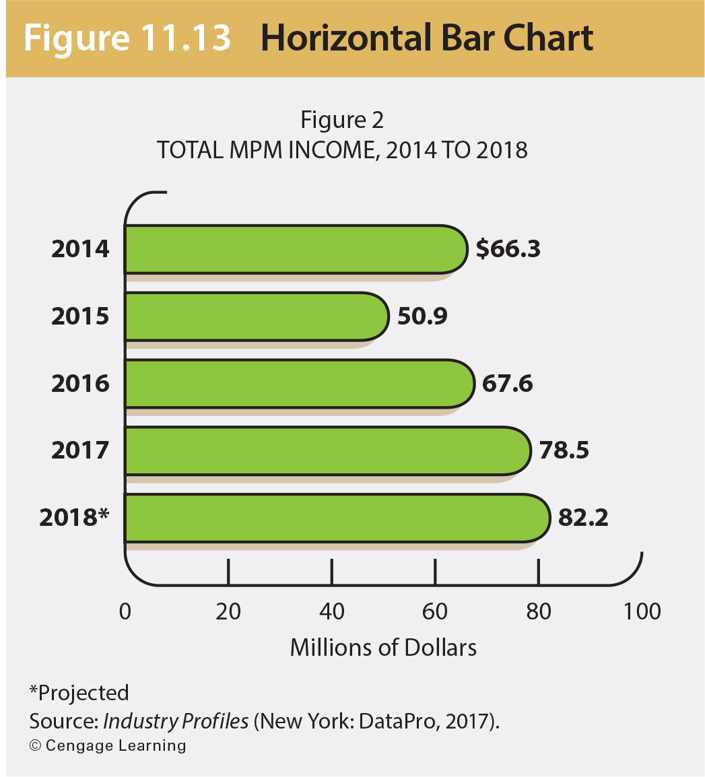
Activate your prior knowledge.
Identify these parts of this graphic: title, label, axis label legend, source note
1
2
3
4

Slide 4
Agenda
Using Graphics
Graphics Homework
Formatting numbers, dates, money and mechanics
Memo Format

Slide 5

Grammar Bytes! BONUS OTHER WRITING GRADE
Complete a grammar exercise on a topic covered in this course. Then, send Prof. Ballantyne a screen capture of the last screen.
Go to chompchomp.com!
chomp!
chomp!

Slide 6

Graphics Homework
DUE DATE: FRIDAY FEBRUARY 8th
Graphics

Slide 7
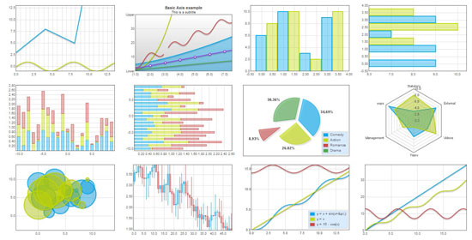
Graphics
Why do we use them?
What do they add?
Graphics

Slide 8
Creating Effective Graphics
Functions of graphics
To clarify data
To create visual interest
To condense and simplify data
To make numerical data meaningful

Slide 9
Using Graphics
Put your audience first. Perform an audience analysis and create using a “you” view.
Set it up. Introduce your graphic clearly so that it is a seamless part of the document.
Exercise restraint. Limit your colours and fonts, just like you would for other elements of document design.
Be precise. Use accurate information and a logical graphic for the information.
Tell a story. A good graphic will help you to illustrate your main point and your purpose at a glance.
Cite it properly. Use descriptive titles, labels and a clear citation.

Slide 10
A good graphic tells a complete story.
Provide a meaningful written introduction to the graphic
Clear Labels
Complete title
Labeled axes (if necessary)
Clear legend (if necessary)
Source note

Slide 11
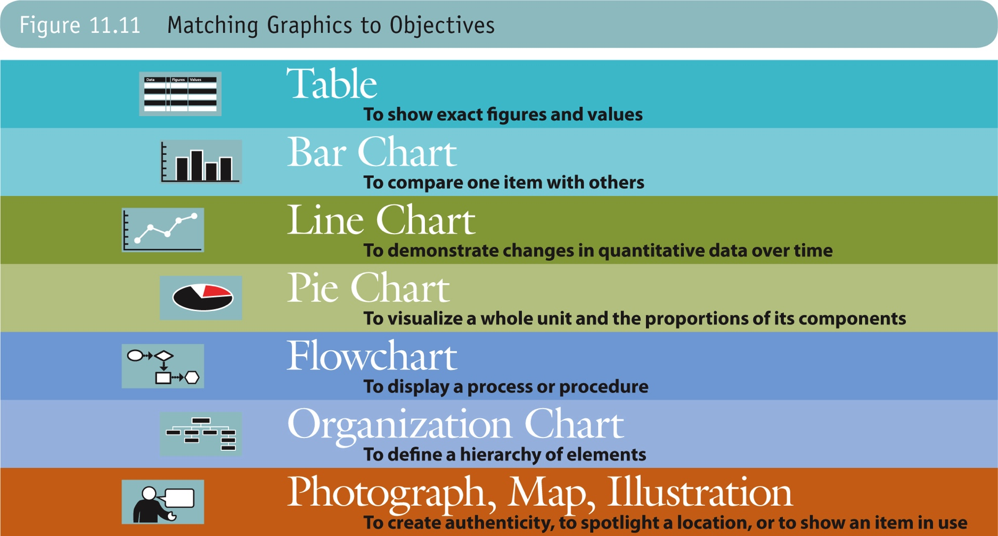

Slide 12
Table
Figure 1 Table of Graphics with Objectives
Type of Graphic | Objective
Table | To show exact figures and values
Bar Chart | To compare one item with others
Line Chart | To demonstrate changes in quantitative data over time
Pie Chart | To visualize a whole unit and the proportions of its components
Flowchart | To display a process or procedure
Organizational Chart | To define a hierarchy of elements
Photograph, Map, Illustration | To create authenticity, to spotlight a location, or to show an item in use
Source: Guffey, p. 340.

Slide 13
Table Best Practices
Place titles and labels at the top
Arrange items in a logical order
Provide clear headings for rows or columns
Identify the units in which figures are given
Use N/A for missing data
Make tables readable with shading alternative lines or leaving blanks after every 5th entry
Place tables close to where they are mentioned in the text

Slide 14
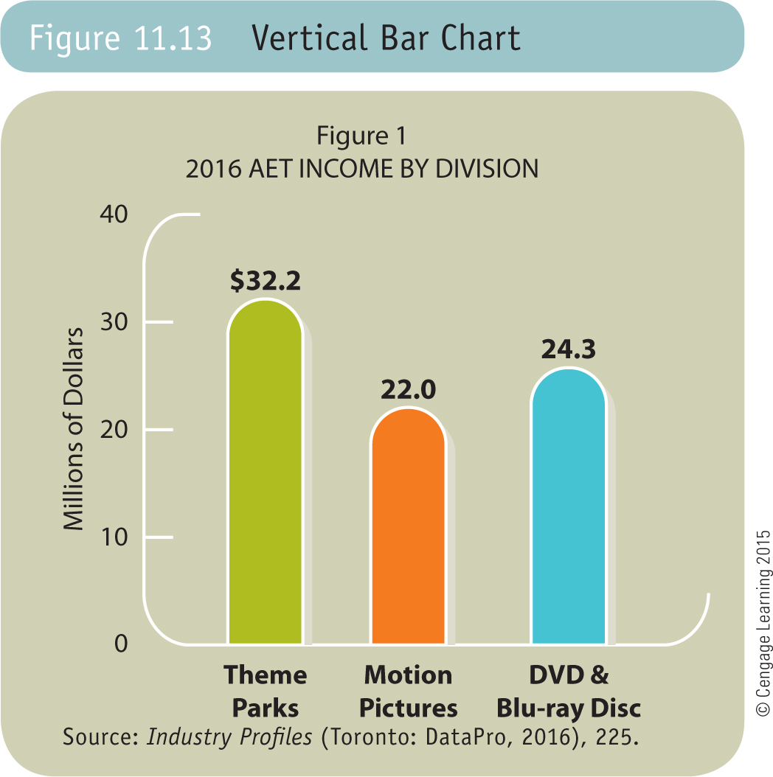
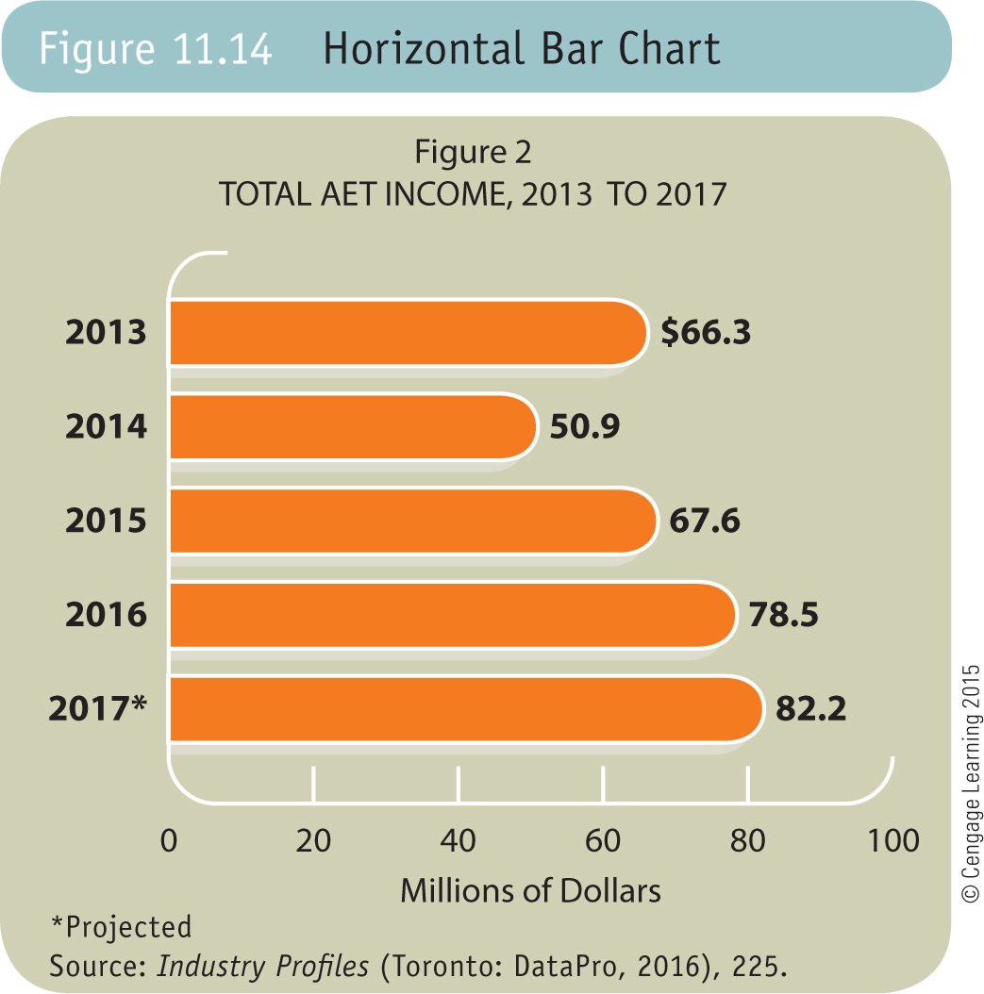
Bar Charts

Slide 15
Bar Charts Best Practices
Use bar charts to make visual comparisons. Compare related items, illustrate changes in data over time, or show segments as parts of wholes.
Make bar charts in vertical, horizontal, grouped, or segmented forms. Avoid showing too much information, thus producing clutter and confusion.
Make the length of each bar and segment proportional.
Start dollar or percentage amounts at zero.

Slide 16
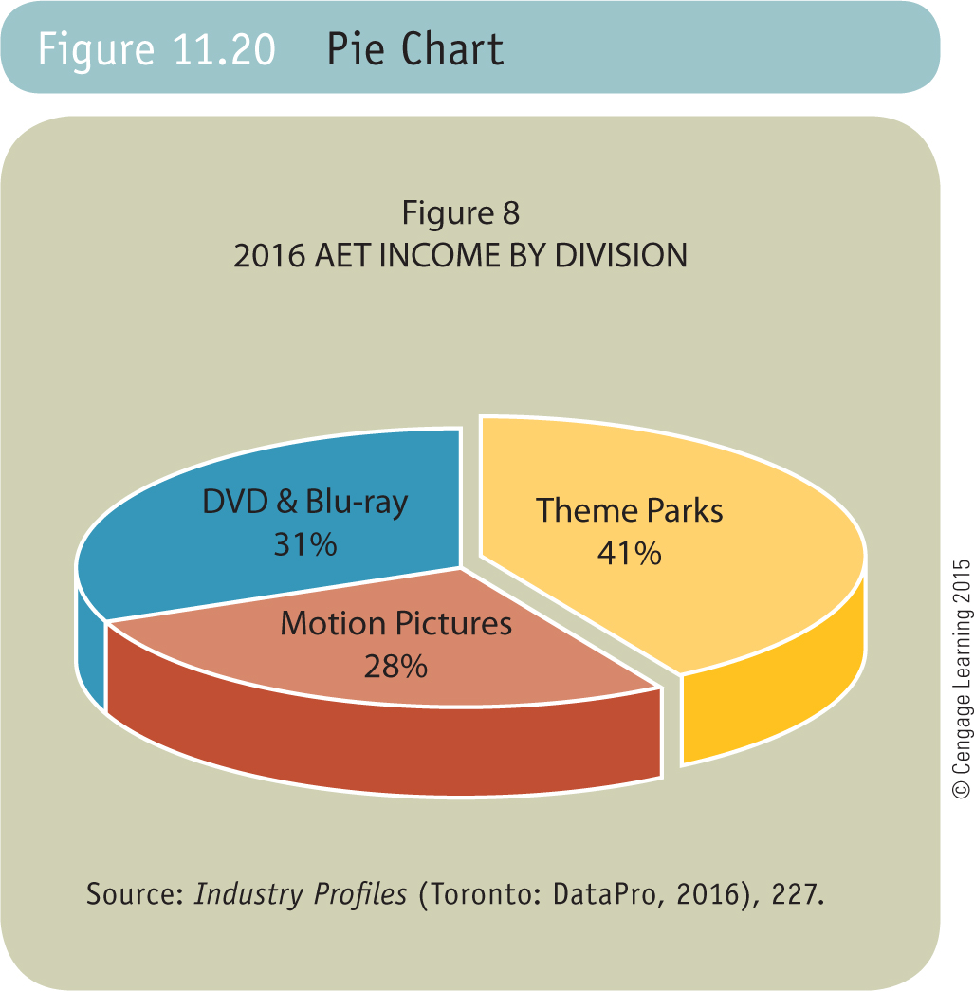
Pie Charts

Slide 17
Pie Charts Best Practices
Use pie charts to show a whole and proportion of its components.
Generally begin at the 12 o’clock position, drawing the largest wedge first.
Include, if possible, actual percentage or absolute value for each wedge.
Use four to eight segments for best results; if necessary group small portions into one wedge called “Other.”
Distinguish wedges with colour, shading, or cross-hatching.
Keep all labels horizontal.

Slide 18
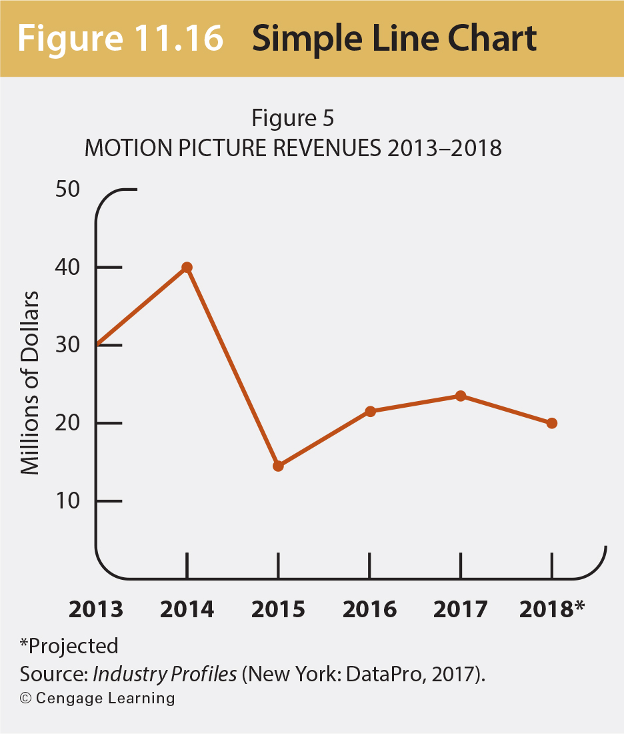
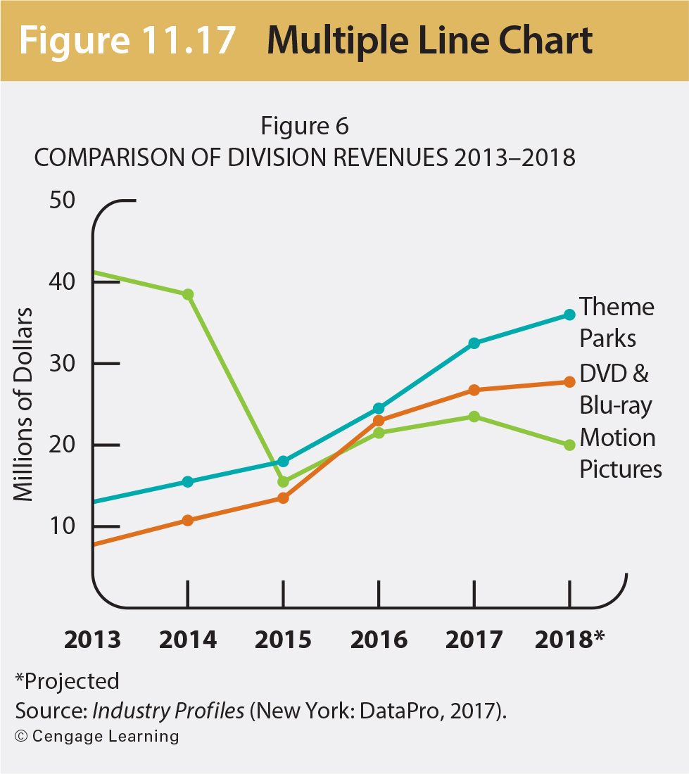
Line Charts
Copyright © 2019 by Nelson Education Ltd.

Slide 19
Line Charts Best Practices
Use line charts to show changes over time and indicate trends
Arrange the time component (usually years) horizontally across the bottom
Arrange values for other variable vertically
Draw small dots at the intersections to indicate each value at a given year
Connect the dots and add colour

Slide 20
Which type of graphic should we use? Why?
Show quarterly revenue of Barbie sales over the last four years.
Compare the number of users for all the major search engines for today.
Track the number of refugees coming into Canada over the last five years.
Compare the amount of chocolate to the other ingredients in a Snickers bar.

Slide 21
Graphics Homework Assignment
Use the data table on Brightspace to create one graphic (pie, bar, or line). Place the graphic and a relevant, meaningful observation about the data in the body of a 3-part direct response memo.
The memo should be addressed to Emily Ballantyne.
It should be related to your work with Harvest Grocery, so write it from your position as Administrative Assistant.
DUE: Friday, February 8, 9:00 a.m. Submit to turnitin.com

Slide 22

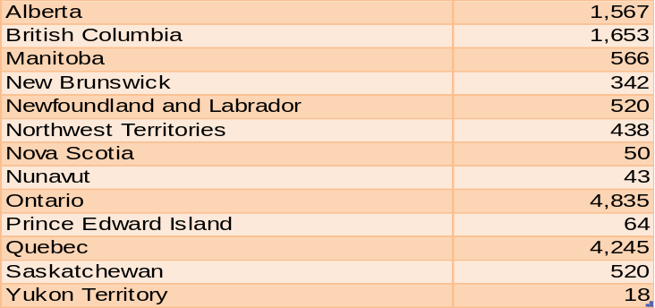
Select data from the set below to create one graphic. Do not include the table provided.
Write a one-sentence introduction to your graphic that introduces it by number and tells your reader what to note.
In 2017, Statistics Canada published this data set. Their findings report grocery stores across Canada by the end of 2016.

Slide 23
Graphic Homework should include…
Appropriate direct strategy memo format
Meaningful introduction to the graphic
Complete title
Labeled axes
Clear legend
Source note

Slide 24
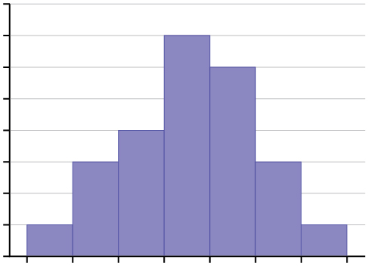
Practice
Meaningful introduction to the graphic
Labels
Complete title (Who, What, Where, Why)
Labeled axes
Clear legend
Source note
Sample Graph

Slide 25
Graphics Homework: Memo Format
TO: Emily Ballantyne
FROM: your name
DATE: February 8, 2019
SUBJECT: informative subject line
[no greeting]
OPENING
BODY: introduction to graphic/meaningful observation
CLOSING
[no complimentary close/signature block]

Slide 26
Direct Analytical Memo
Use memo format for most short informal reports
Use an informal, conversational style
Start with purpose
Put your recommendations up front

Slide 27
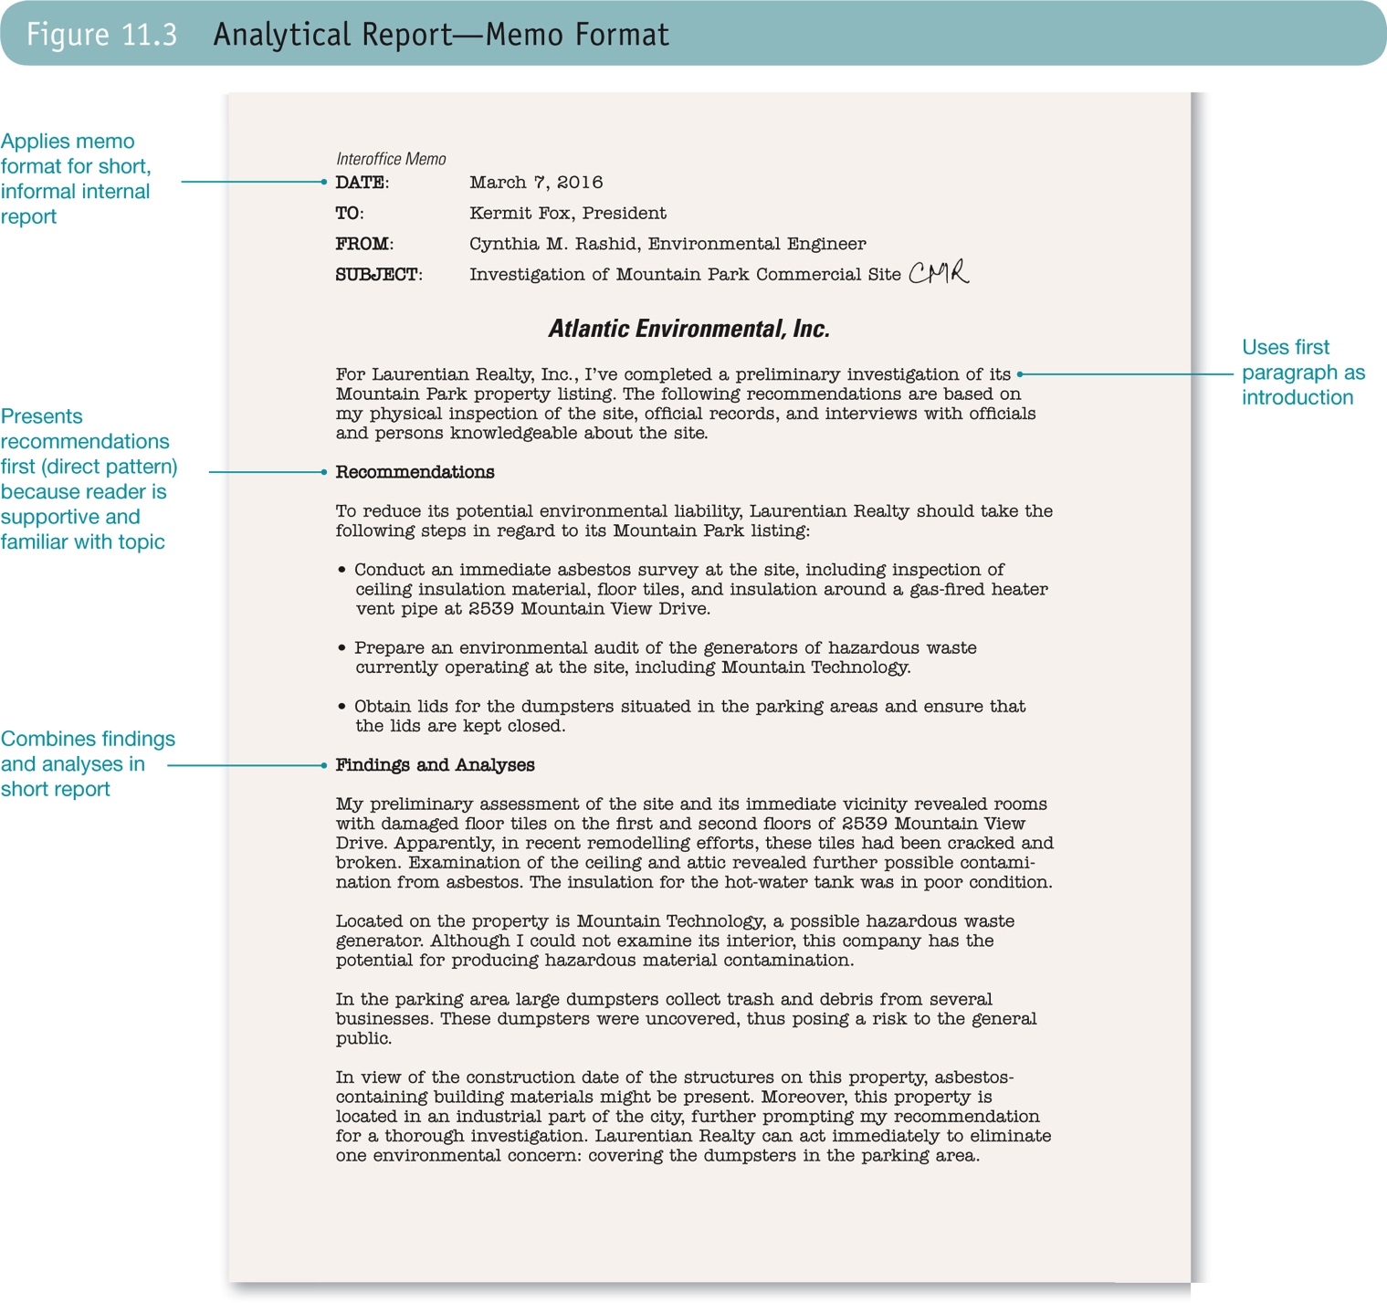

Slide 28
Practice Labeling a Chart
From Exercise 11.11 (p. 352)
Prepare a line chart showing the sales of Sidekick Athletic shoes for 2010-2015. In the chart title, highlight the trend you see.
Include the following:
Meaningful introduction to the graphic
Labels
Complete title
Labeled axes (if necessary)
Clear legend (if necessary)
Source note

Slide 29
Label this chart.

Slide 30

Rules to Follow
This Photo by Unknown Author is licensed under CC BY

Slide 31
Capitalization
Specific names (e.g. Prof. Ballantyne, Saint Mary’s University,)
Business titles before a name (e.g. Professor Emily Ballantyne, Course Editor Angela Garofolo)
Languages (e.g. English, Mandarin, Arabic)
Countries (e.g. Canada, United Arab Emirates)
Nationalities (e.g. Canadian, Indian, Vietnamese)
Religions (e.g. Buddhist, Muslim, Christian)
Main words in a title or heading (e.g. What Words to Capitalize in a Sentence)

Slide 32
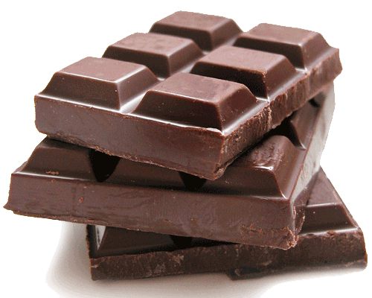
Numbers
Use words for numbers one through ten
e.g. There are only five chocolate bars.
Use figures for numbers over ten
e.g. I wish I had 100 chocolate bars.
Use figures if the sentence uses both numbers under and over ten
e.g. I ate 2 chocolate bars last week and 11 the week before.
Use words and figures for large numbers
e.g. If I had $10 million dollars, I would buy shares in Dove.
This Photo by Unknown Author is licensed under CC BY-SA
This Photo by Unknown Author is licensed under CC BY-SA

Slide 33
Dates
Use this format: Month Day, Year
June 28, 2014
August 27, 2019

Slide 34
Money
For exact amounts of money, use the dollar sign with figures, not words.
e.g. Last week, President’s Choice chocolate bars were on sale for $3.99. They usually cost $4.49.

Slide 35
Time of Day
Write the time of day using the twelve hour clock, adding a space between the figures and the a.m. and p.m.
5:15 pm
9:00 am

Slide 36

Kahoot!
Notes:
Program
Year
Reason for choosing this class
Important feature of good writing
Biggest writing problem

Slide 37
For Tuesday
Persuasive Writing and AIDA
Read: Chapter 10: 237-252
Chapter 5: 113-115
Coursepack: 17-19
Appendix B: 18-19
Review: Graphics Homework
Write: Graphics homework

